Slide 1
ECE 530 Cloud Computing
Ioannis Papapanagiotou
AWS Networking

Slide 2
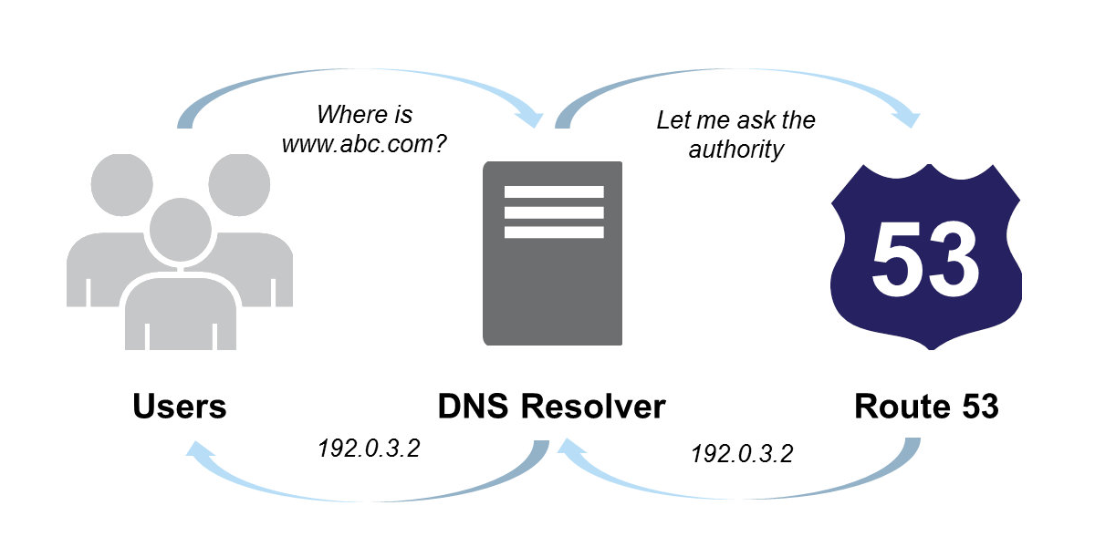
Networking #1 (DNS)
Router 53: a highly available and scalable cloud Domain Name System (DNS) web service.
Notes:
Designed to give developers and businesses an extremely reliable and cost effective way to route end users to Internet applications by translating names like www.example.com into the numeric IP addresses like 192.0.2.1 that computers use to connect to each other.

Slide 3
Networking #2 (VLAN)
AWS Direct Connect makes it easy to establish a dedicated network connection from your premises to AWS.
Using 802.1q VLANs, this dedicated connection can be partitioned into multiple virtual interfaces.
Client can use the same connection to access public resources such as objects stored in Amazon S3 using public IP address space, and private resources such as Amazon EC2 instances running within an VPC using private IP space, while maintaining network separation between the public and private environments.

Slide 4
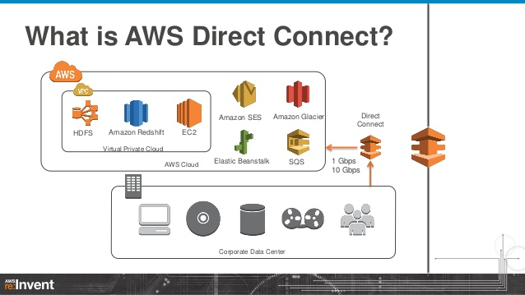
AWS Direct Connect

Slide 5
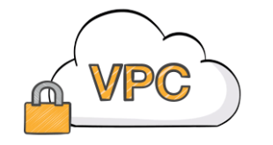
Virtual Private Cloud (VPC)
Amazon VPC lets you provision a logically isolated section of the AWS Cloud where you can launch AWS resources in a virtual network that you define.
For example, you can create a public-facing subnet for your webservers that has access to the Internet, and place your backend systems such as databases or application servers in a private-facing subnet with no Internet access.

